Slide 1
The guide to parkour
BY: Sehel & Karim

Slide 2
What is parkour?
Parkour is a type of workout, it’s a way to see your surroundings faster then before. And to get more fit(It’s better to do parkour with someone).

Slide 3
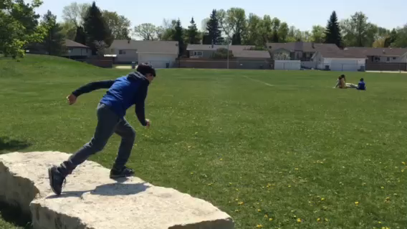
Safety Rolls
Safety Rolls are the Most basic Rolls in the parkour universe

Slide 4
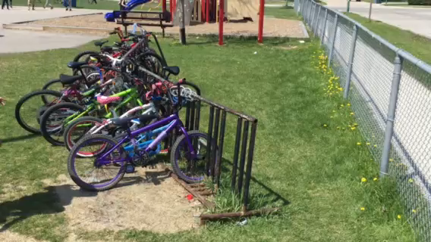
The vault
The vault is one of the most Helpful moves in parkour. It helps you overcome obstacles for a beginner

Slide 5
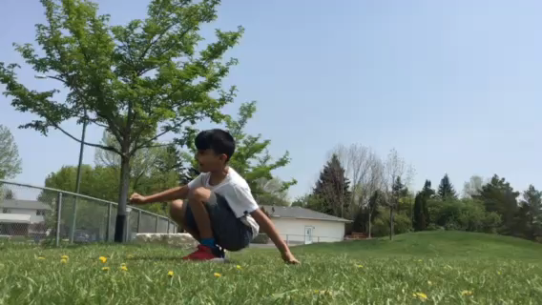
macaco
A macaco is a form of back flip, you do this to practice the form of a backflip

Slide 6
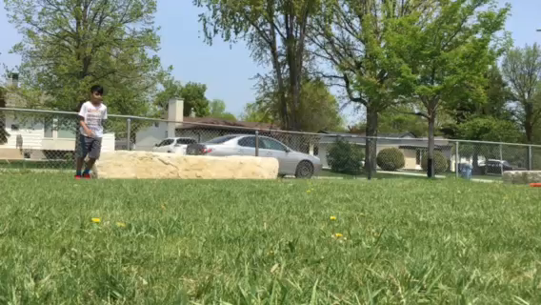
Dive roll
A dive roll is an acrobatic stunt that begins with a horizontal forward diving motion and results in a forward somersault

Slide 7
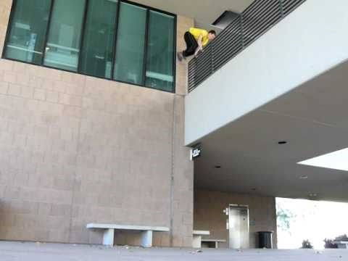
Wall run
The Wall Run is a widely used movement in Parkour, used to get over a wall too high for a vault. It is also used in Free running

Slide 8
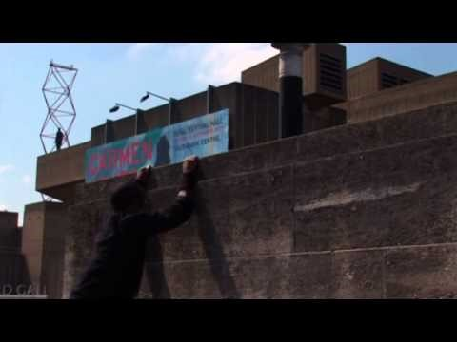
Cat leap
The Cat Leap (also known as the arm leap or arm jump) is a technique used in Parkour and Free running to land on a vertical object, such as a ledge, a wall, or a fence. Cat leaps are one of the most common techniques used, and should be learned and practiced at an early stage. They can be done from a running jump, a precision, a lache or a number of other techniques.

Slide 9
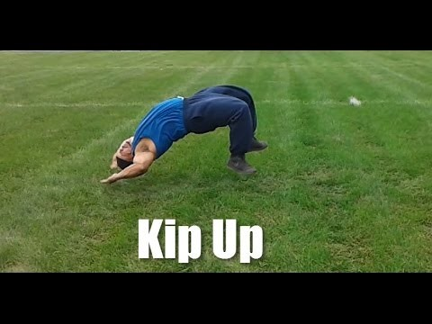
Kip up
A kip-up is an acrobatic move in which a person transitions from a supine, and less commonly, a prone position, to a standing position. It is used in activities such as breakdancing, gymnastics, martial arts, professional wrestling, and free running, and in action film fight sequences

Slide 10
We both hope you enjoyed and learned some thing from this slideshow. Thank you for your time!

